Slide 1
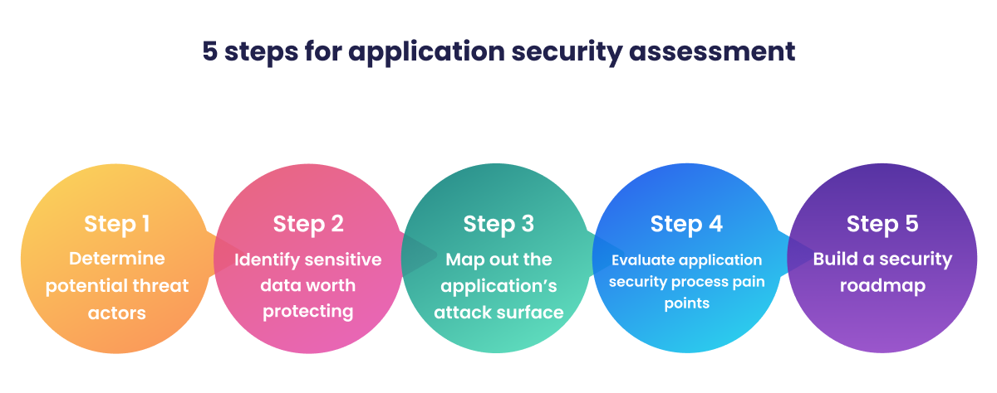
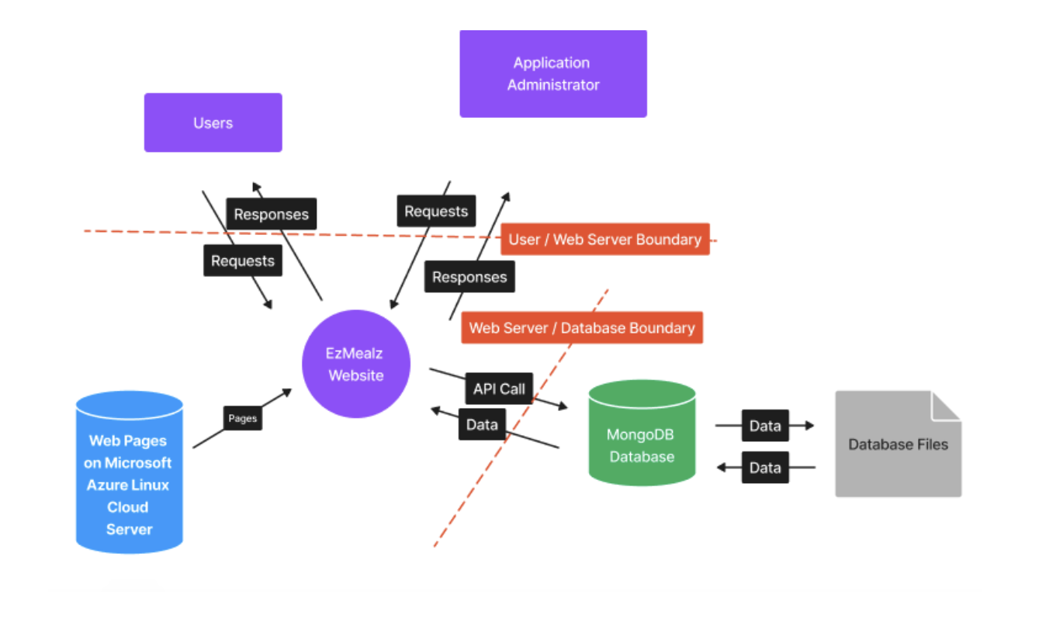
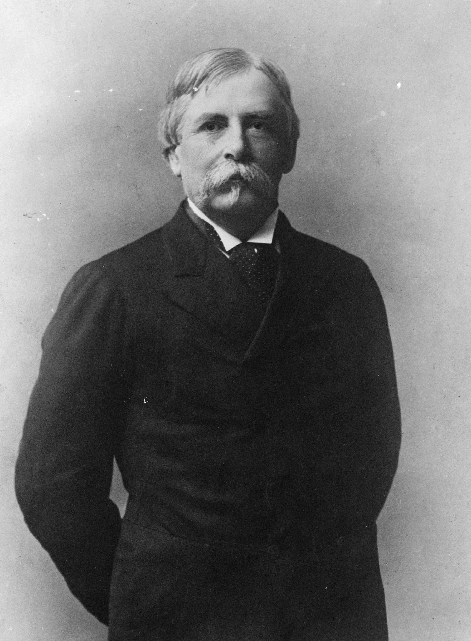
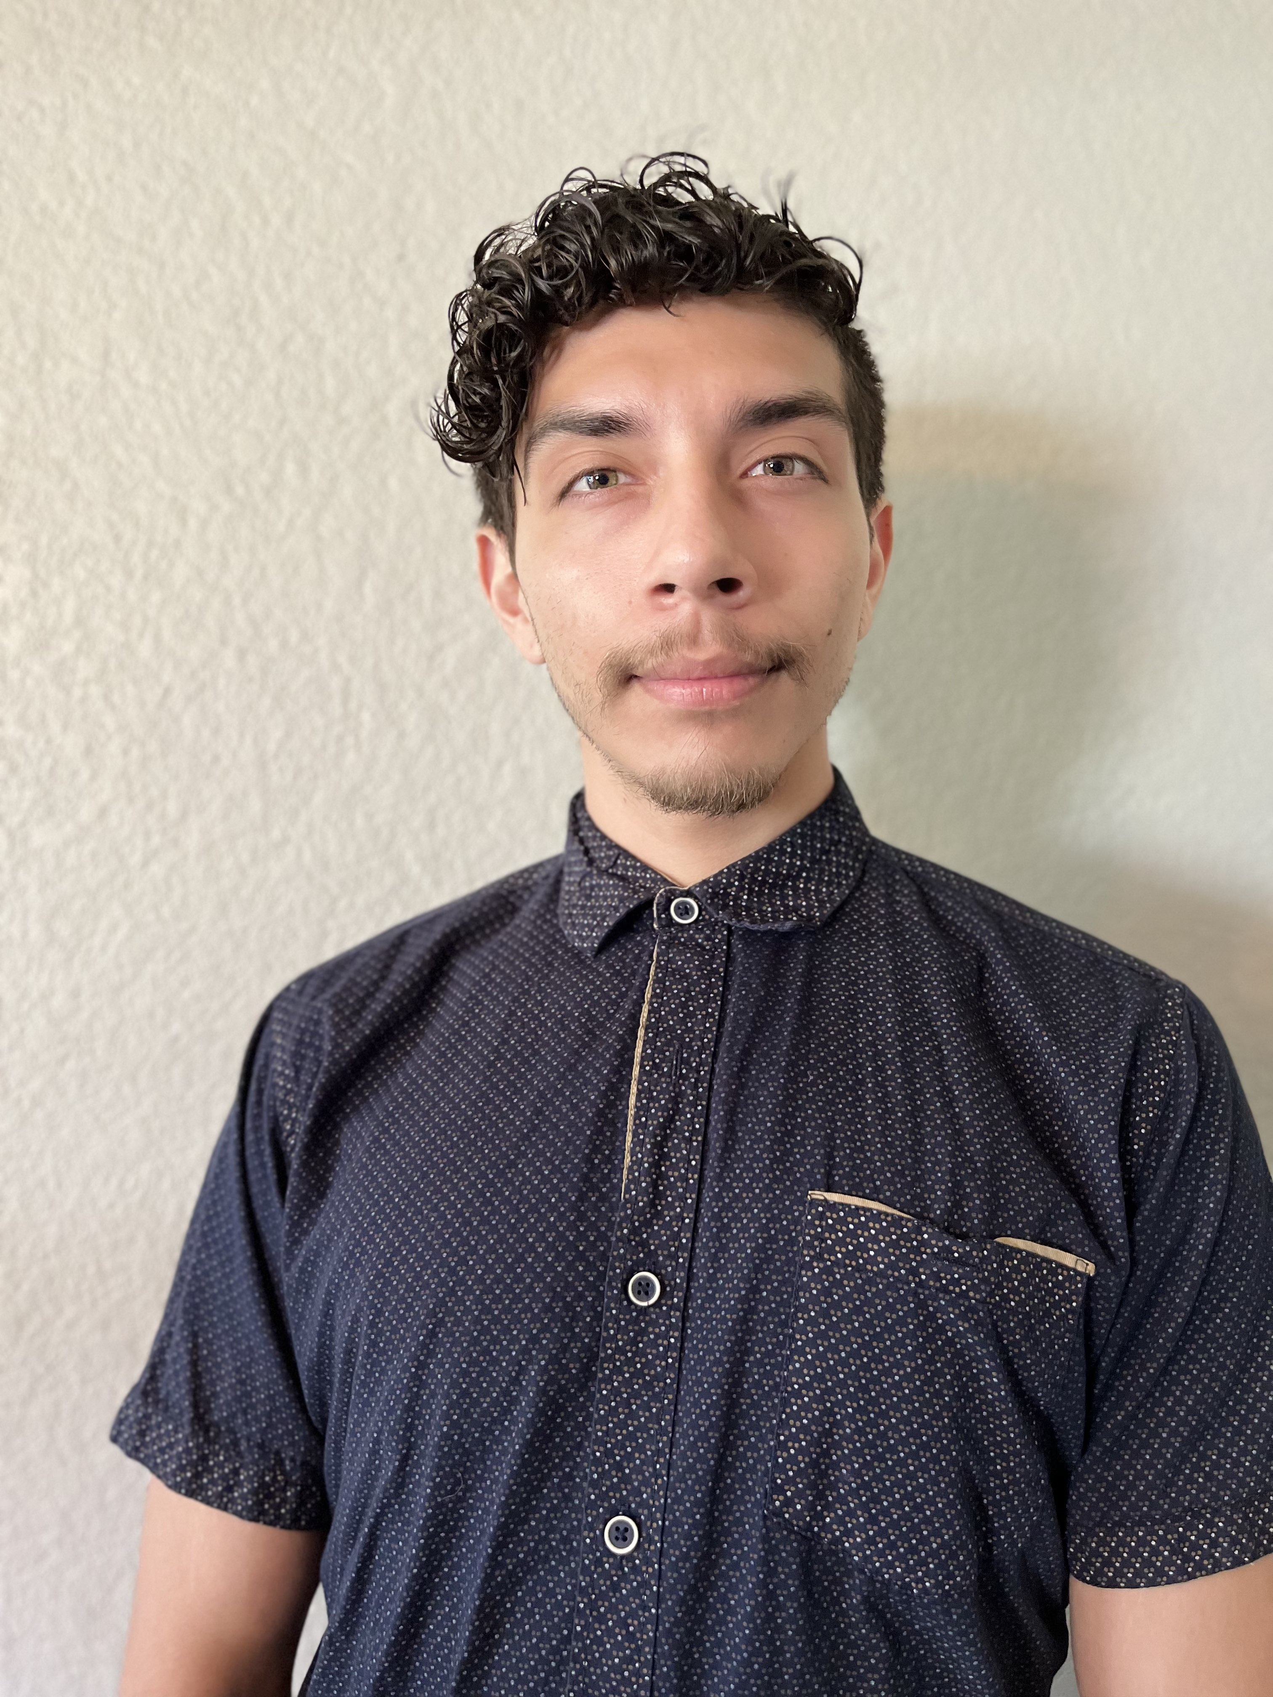
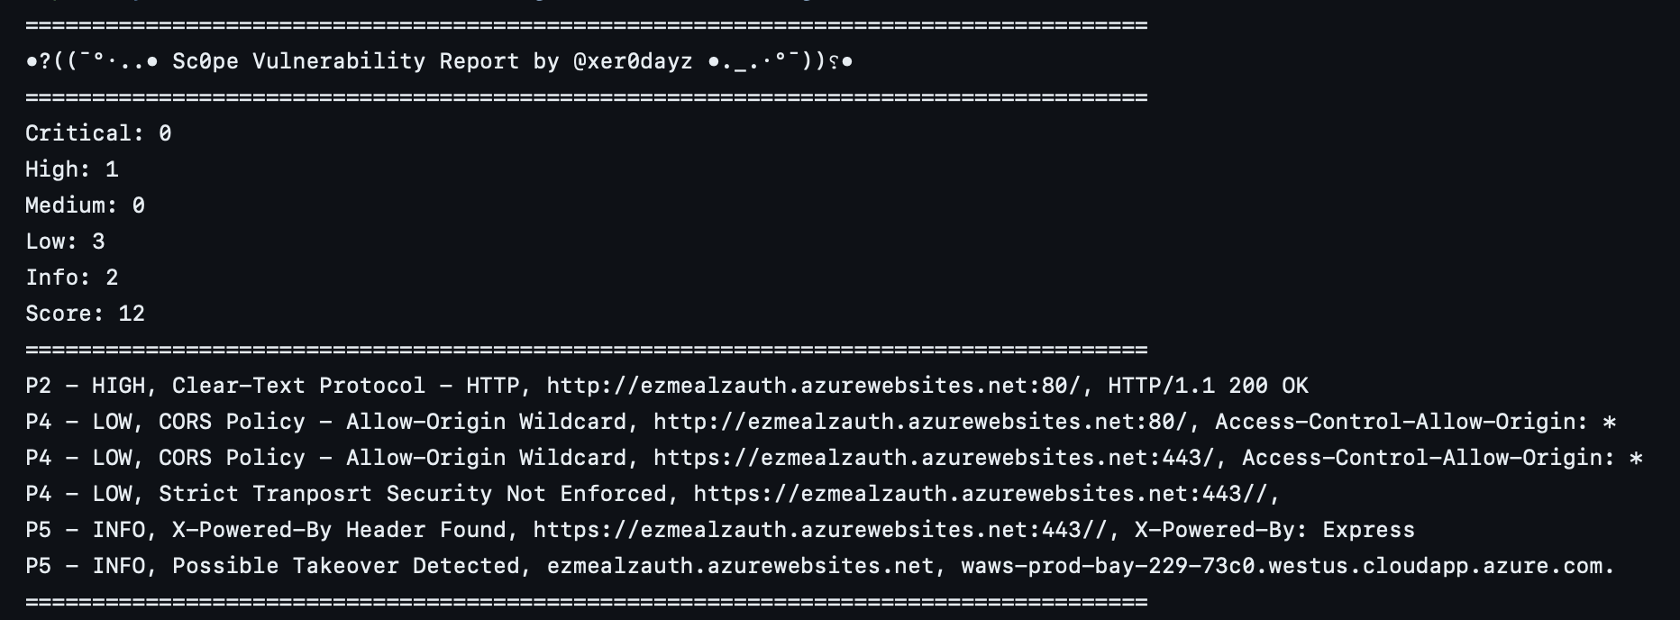


CS.096
Security Competition
acknowledgements
Cybercrime estimated at $8.4 trillion U.S. dollars in 2022
William Endicott
Crafts Team technical lead: Conducted all required testing and threat modeling. Group expert regarding all cyber security information.
Ian Delgado
EzMealz Technical lead: Worked towards login authentication and subscription service improvement. Assessing all interactions with user and database for utmost security
Alanna Croysdale
EZ Meals Research Lead: Created threat modeling and analysis, research of web application security and managed documentation.
Sunwoo Kim
Crafts Team Research Lead: Worked with other project group, learned requirements for OSU security policies and industry standard documentation
Kirsten Winters
Project Partner:
Security Consultants aim to help businesses secure data
Cybersecurity assessments are an all-encompassing task to review a project. These assessments range from ensuring a company’s physical network infrastructure is secure to discovering any vulnerabilities in remote attacks. Instead of creating a new technology that will be faster or more efficient, our primary goal is to ensure safety for businesses and the public. The threat of competitors causes companies to release technology as fast as possible however this speed comes with the risk of vulnerabilities. Our project aims to discover and patch any vulnerabilities in cybersecurity assessments to safeguard our clients.
Security assessments aim to prevent unauthorized access to data and data leaks, thus protecting the client from the inconveniences of a breach, including liability issues and data loss. In addition, it would save their clients from having their data stolen and, in cases where their clients' reused passwords, used to gain access to users’ other accounts. Furthermore, It will save users time needed to change passwords due to a breach. Finally, it will save the client time and money because the project’s security would not have to be fix when a breach occurs.
Requirements will consist of checking for vulnerabilities within the client's application. Identifying vulnerabilities with the intent to inform and educate will maintain key security attributes, confidentiality, integrity, availability, privacy, authenticity, and accountability. The value brought to the product's user base is a safe and secure way to always use the application with availability. The service provides a detailed explanation of vulnerabilities in the software which lead to data leaks. Our service then works towards a solution to strengthen the client’s application against adversaries.
KEEPING CREATIVITY SAFE: Crafts Team security assessment
EzMealz Security Assessment: A Recipe for Safety and Protection
The project at hand is to design a registration system for the OSU Craft Center that addresses general concerns about safeguarding OSU-owned data and abiding by data security standards. This project's primary beneficiaries are students and non-students alike who are interested in becoming members of the Craft Center and signing up for classes. This project's primary goal is to develop a product that allows users to register for classes and store their information online.
As business and universities adopt more technologies to maintain a competitive edge it’s crucial for these organizations to maintain robust security infrastructure and polices. Cyberattacks and data breaches that occur on a university wide scale would be detrimental for a school’s members and their reputation. This report aims to be an extra security layer by giving valuable insights and spread awareness.
EzMealz is a recipe sharing web application that has subscription based services and gathers sensitive user information that includes names, physical addresses, and credit card information. Protecting sensitive user information is critical for the integrity and privacy of EzMealz. The primary goal of the EzMealz security assessment is to ensure that user information is safeguarded from any adversaries attempting to access unauthorized data.
EzMealz user passwords had added layers of security through hashing and salting passwords. Vulnerability analysis through various web application scanning tools showed a weakness in sanitizing user input that could potentially lead to cross-site scripting attacks. Security recommendations include refactoring code to sanitize user input and having password protocols such as minimum lengths and the use of special characters.

